Slide 1


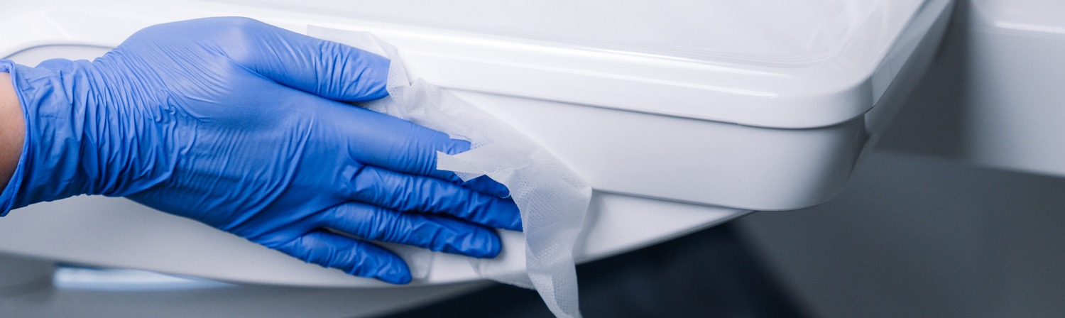
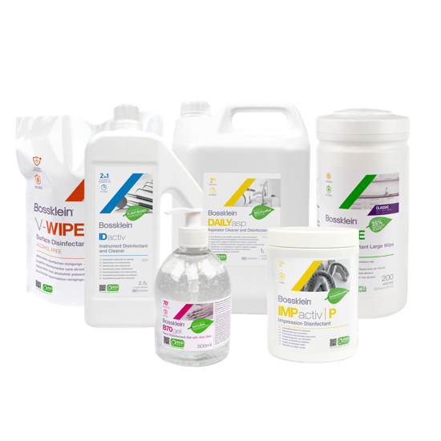

Slide 2

USP - Unique Selling Points
Why choose Bossklein as your infection control partner
Notes:
This presentation will help you learn all about the unique selling points of the Bossklein Complete Hygiene solutions range of infection control products and why you should choose Bossklein as your clinical infection control partner.

Slide 3
What is Bossklein?
Notes:
Its important to understand the basics first and exactly what the Bossklein range is

Slide 4
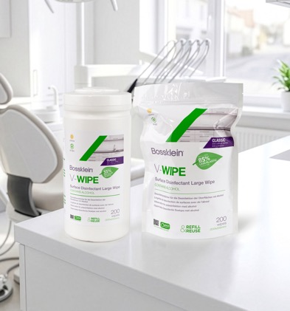
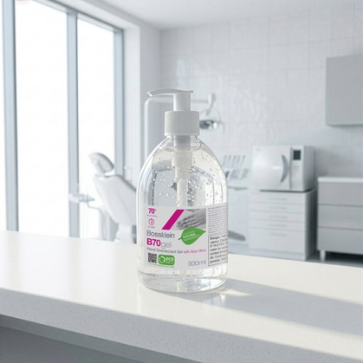
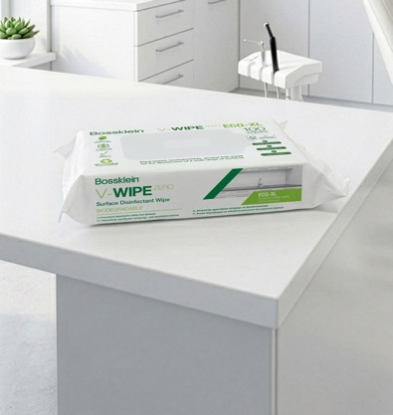
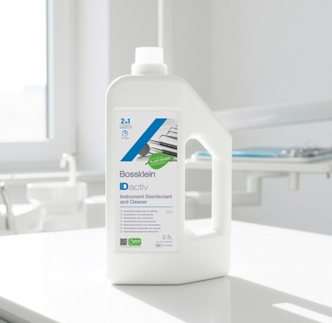
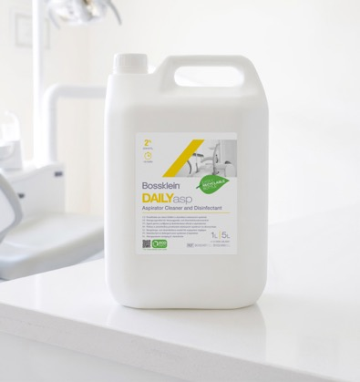
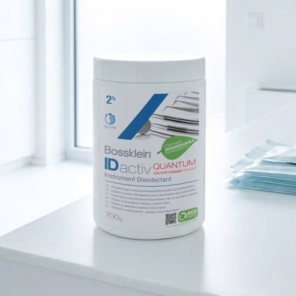
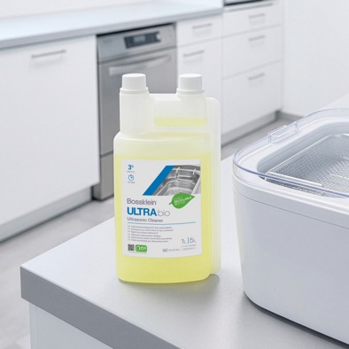
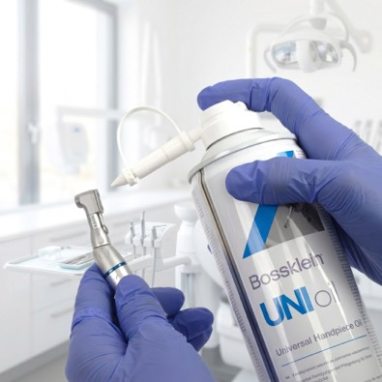
A comprehensive range of
clinical infection control products
Notes:
Bossklein is a complete range of infection control products that is primarily aimed at Dental and Healthcare professionals. Products include advanced disinfection and cleaning solutions targeted at tools and equipment regularly used in clinical environments and wet wipes designed to decontaminate larger surfaces.
All Bossklein products have been specifically designed to lower the risk of cross infection, reduce downtime and protect equipment that is used within professional clinical environments

Slide 5
But what makes Bossklein unique?….
Notes:
Exactly what makes Bossklein unique when compared to other disinfection and cleaning brands?

Slide 6





Clinically Engineered
Designed specifically for dental and medical
Purpose built for specific clinical needs
Increase work flow and safety
Notes:
Bossklein products have been carefully designed to meet the specific needs of busy healthcare professionals. Products are designed to work quickly and efficiently by removing debris and targeting micro organisms that are commonly found within high risk settings.
Our products are tested for compatibility with specific equipment and materials found inside different areas inside the dental clinic. They have been purpose built for the demands of modern healthcare environments.
By reducing contact times we can help speed up the workflow of a clinic and increase the amount of time spent with patients. By targeting specific micro organisms commonly found in clinical environments we can improve the safety for both patients and staff.

Slide 7



Highest Test Standards
EN
Wide ranging
anti-microbial testing
European
Standards
ISO 17025
accredited testing only
Inspire staff & patient confidence
Notes:
Every Bossklein product is tested to the highest European EN standards for ultimate confidence and peace of mind. Our products are registered medical devices ranging from Class 1 up to Class 2B.
Products undergo extensive testing against a range of different micro-organisms that are commonly found within healthcare settings.... including Bacteria, Yeast, Viruses, Spores and Mycobacteria.
Micro-biological testing is exclusively undertaken with ISO 17025 accredited laboratories. Full documented test evidence is available for complete regulatory compliance and total peace of mind.
Comprehensive microbiological testing to the latest standards ensures the risk of cross infection is minimized. Inspiring full confidence and reassurance for clinical teams and patients, each time they visit the clinic.

Slide 8





Manufactured in the UK
Localised supply chain
Consistent quality
Faster response
Complete Manufacturing Control
Notes:
Bossklein products are manufactured in the UK. The vast majority of components are sourced within the United Kingdom and, where ever possible, using local suppliers. This reduces their environmental impact and improves delivery times.
By building relationships with companies we trust and restricting our supply chain to partners with established reputations for both high quality components and top class service, we can deliver consistent high quality products to the exacting specifications demanded for medical devices.
Working with suppliers geographically closer to our manufacturing facility in the UK enables a quicker response to customer needs and ultimately leads to a shorter delivery time for finished goods.
All of these elements provide Bossklein with complete control over the entire manufacturing process. From raw materials, through to packaging and right up to the finished product.

Slide 9





Speed is key
Engineered for speed
Rapid contact times
Increased efficiency
More time with patients
Notes:
Speed and efficiency is vital for healthcare facilities. All Bossklein product formulations have been designed to include modern active ingredients that get to work quicker than their predecessors.
Achieving wide spectrum efficacy with short contact times is difficult but vital inside a modern dental or healthcare setting. For example, our V-WIPE range of wet wipes is proven to be fully effective against a wide spectrum of micro organisms in only 60 seconds. This makes them the ideal wipe to use between patients ... where speed is key.
By speeding up processes and reducing downtime, Bossklein can help clinics operate more efficiently.
This allows dental teams to spend more time with patients and ultimately increases the overall number of patients that can be seen per day, per week and per month.

Slide 10






Recycle • Reuse • Refill • Recycle • Reuse • Refill
Natural
Ingredients
Recycle
Reuse
Refill
Eco-friendly
Philosophy
Scannable
Labels
ZERO Performance
Compromise
Reduced Plastic
Look out
for the leaf
Notes:
Bossklein’s Future First Eco friendly philosophy is to try and reduce the harmful materials used and wasted.
Product formulations have been designed make use of natural ingredients including; detergents made from plant based ingredients, renewably sourced wipe materials and biodegradable components
We encourage users to Recycle, Reuse and Refill. All our primary packaging is fully recyclable plus we offer refillable and reuseable containers for our wipes and solutions. This results in less waste being sent to landfill.
Bossklein push to reduce plastic consumption in packaging. We have reduced the total amount of plastic in our containers, switched to packaging that utilizes recycled content and shrunk packaging to fit products more closely and ultimately reduce waste.
Without compromising product performance, where possible we have switched raw materials in our product formulations if there is an more eco friendly equivalent.
All Bossklein product labelling now includes eco fact headlines with a scannable link to our website for full details. Look out for the leaf on the front of each product.

Slide 11
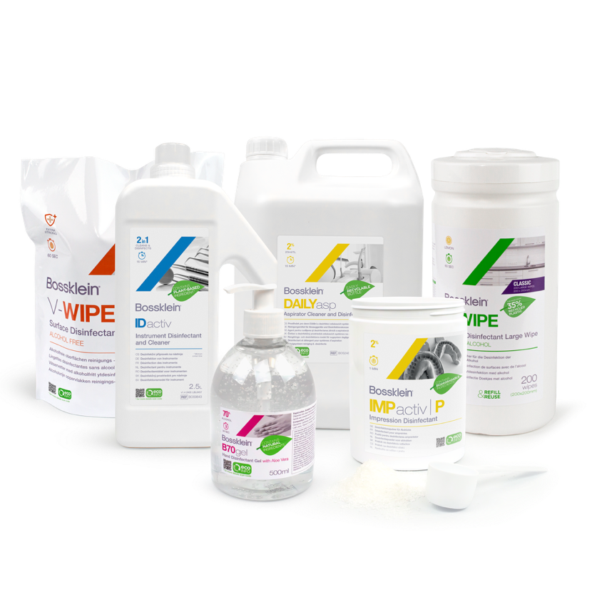

bossklein.com
Notes:
Thank you for taking the time to learn about what makes Bossklein stand out from other disinfectant brands and why Bossklein is the perfect hygiene partner for any modern dental practice.

